Slide 1
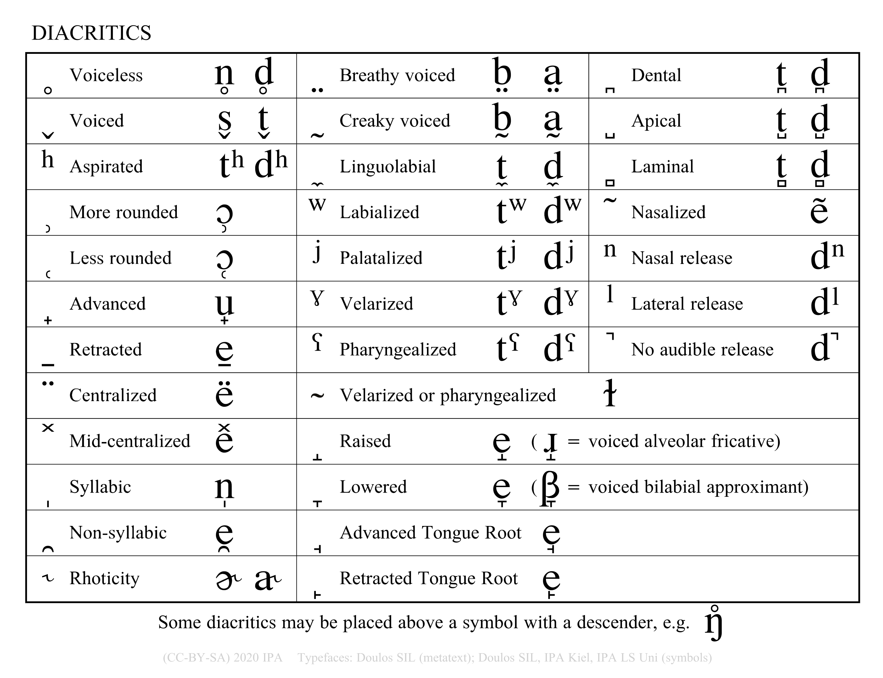

Correct / Incorrect use of Diacritics
Some of the transcriptions below use diacritics incorrectly.
Identify the errors & explain the problem. (Answers on next slide.)
plain [plẽn]
licked [l̬ɪkt]
freed [fɹ̥id]
speed [sp⁼id]
plaid [p̥lad]
tenth [tɛn̪θ]
licked [lɪkˠt]
tenth [tʰɛnθ]
hark [h̥aɹk]
practice [ˈpɹak˺tɪs]
tool [tʷul]
created by Antoin Rodgers under Creative Commons Attribution-ShareAlike 4.0 License - rodgeran@tcd.ie - @phonetic_antoin

Slide 2
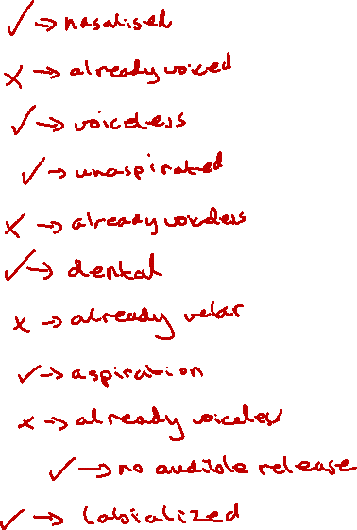
Correct / Incorrect use of Diacritics
Some of the transcriptions below use diacritics incorrectly.
Identify the errors & explain the problem. (Click / Hit right arrow to see answers.)
plain [plẽn]
licked [l̬ɪkt]
freed [fɹ̥id]
speed [sp⁼id]
plaid [p̥lad]
tenth [tɛn̪θ]
licked [lɪkˠt]
tenth [tʰɛnθ]
hark [h̥aɹk]
practice [ˈpɹak˺tɪs]
tool [tʷul]
created by Antoin Rodgers under Creative Commons Attribution-ShareAlike 4.0 License - rodgeran@tcd.ie - @phonetic_antoin

